Slide 1
House Features
That Affect
Home Sale Price
in Ames, Iowa
Presented by Leticia Genao
Notes:
Hello, my name is Leticia Genao, and my presentation topic is about identifying which house features affect the Sales Price of homes in Ames, Iowa.

Slide 2
Problem Statement
Already placed as the 64th best city to live in the US according to a study by Livability Ames, Iowa is a popular living destination for Americans. Close to Iowa State University, it is a popular place for graduates and families to settle down.
This project aims to explore trends in Ames, Iowa housing data and seeks to identify housing features that increase the Sale Price of a house. This would allow real estate investors to better invest in the houses being built and get the most bang for their buck.
MYHOME
REAL ESTATE
Notes:
To start, Ames is one of the best cities to live in the US. It’s known for its affordability with median housing prices averaging just $200,000. It’s home to Iowa State University and is a known destination for recent graduates, new families, and even entrepreneurs looking to open up businesses to move to.
https://livability.com/best-places/2021-top-100-best-places-to-live-in-america/top-100-2021-ames-ia/
With Ames becoming an increasingly popular area to live, the problem I came to solve is analyzing housing data in Ames to identify trends, and seek housing features that increase the Sale Price of a house to allow real estate investors to better invest their funds and get the most bang for their buck.

Slide 3
Brief Overview of Data
Description: Information on home assessment values for properties in Ames, IA from 2006-2010.
Size of the Train Dataset: 2051 observations (rows), 81 variables (columns)
Type of Variables
The 82 columns include 23 nominal, 23 ordinal, 14 discrete, and 20 continuous variables (and 2 additional observation identifiers).
Observation identifiers: ID, PID
Notes:
Let me introduce you to the dataset I worked with in my analysis, the Ames Iowa Housing Dataset. The dataset contained information on the value individual homes sold in Ames, IA from 2006 to 2010 split into train and test sets.
The train and test site were identical in features, but the train set contained an additional Sales Price column.
The data did contain inconsistencies which I cleaned. To briefly summarize, some the cleaning consisted of
Filling in missing values with appropriate fields the home did not have
For the missing object types I input the string “none”
And for integers I replaced the nulls with 0’s
Correcting incorrect data types
Identifying outliers 3 standard deviation from the feature mean and removing them
Scaling data after defining features for model.
Dummy coding the neighborhood variable

Slide 4
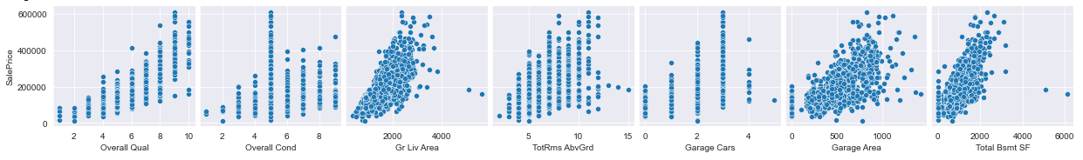
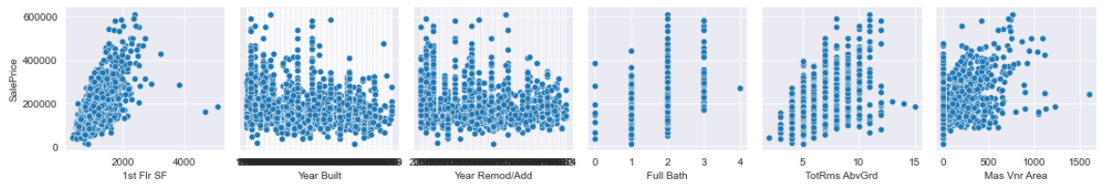
Visualizations - Scatterplot of Features Relative to Sales Price
Notes:
To start, I did scatterplots of my columns to Sales Price to see which features had a linear relationship. I found Overall Quality, Ground Living Area, Garage Area, Total BSMT SF, 1ST FLR SF, Total RMS ABV Ground to have linear relationships, but contained outliers which I removed.

Slide 5
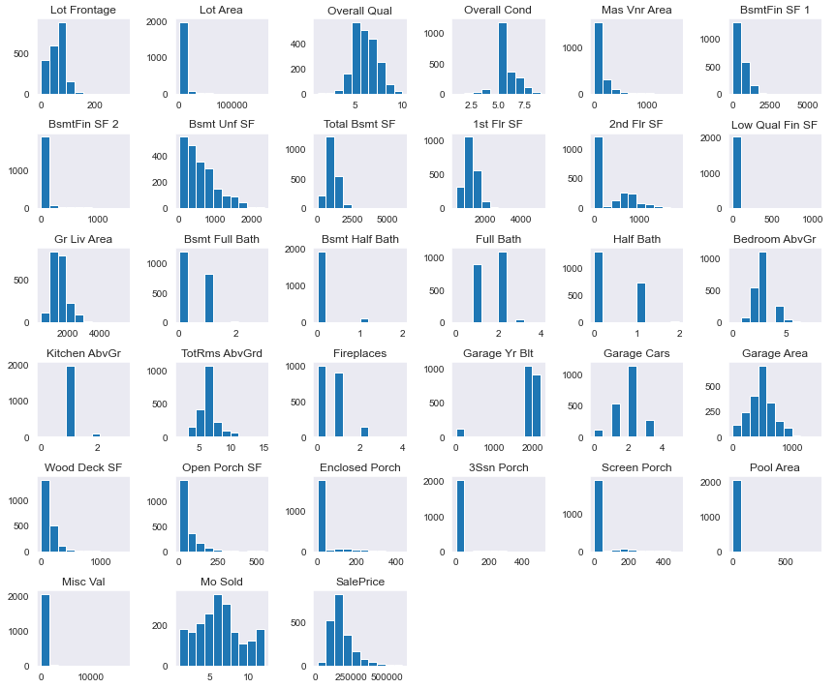
Visualizations
Histogram
of Columns
Notes:
I checked the distribution of the features as well to check for any outliers and peak in the data, and which way the features were being skewed

Slide 6
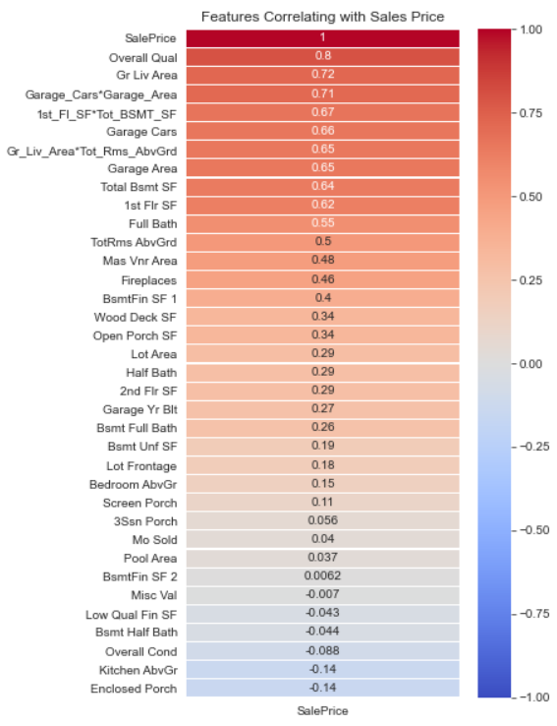
Visualizations - Correlations
Correlating Features to Sales Price Chosen
Overall Quality - 0.8
Ground Living Area - 0.72
GarageCars*GarageArea - 0.71
1stFloorSF * TotBSMTSF - 0.67
Full bath - 0.55
FirePlaces - 0.46
WoodDeck SF - 0.34
Open Porch SF - 0.34
Lot Area - 0.29
Notes:
Next, I looked to see which of the 81 features had high correlations to sales price. After inspection of the correlation I found features that could be considered together and selected them into my model as interaction terms detailed by the asterisk symbol. After many models, these were the top features I ultimately found that affected Sales Price the best and reduced RMSE the most.
Note: Ground living area (above ground)

Slide 7
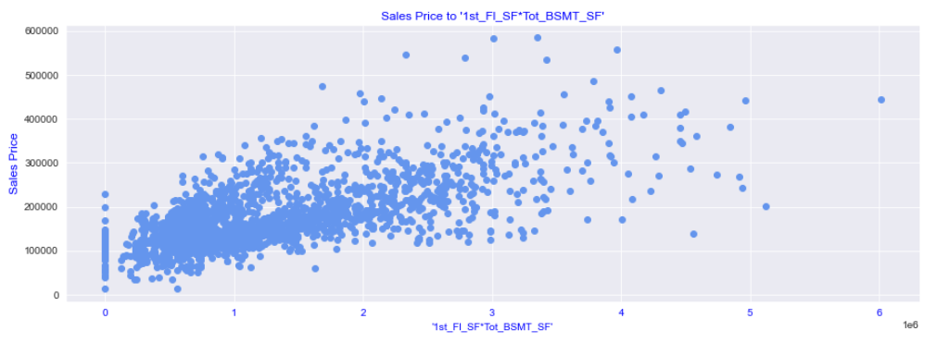
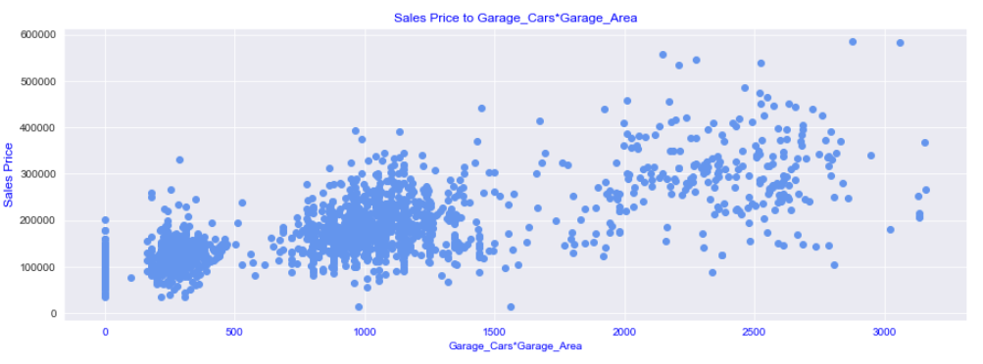
Visualizations - Interaction Terms
Sales Price to
1st Fl SF * Tot BSMT SF
Sales Price to
Garage Cars * Garage Area
Notes:
Closer inspection of the selected interaction terms of 1st floor to basement square footage, and garage cars to garage area show the following scatterplots. While the observations seems be widely dispersed it has a linear relationship to sales price. Post plotting, I removed all outliers 3 standard deviation from the feature mean to eliminate bias-ness in my model.

Slide 8
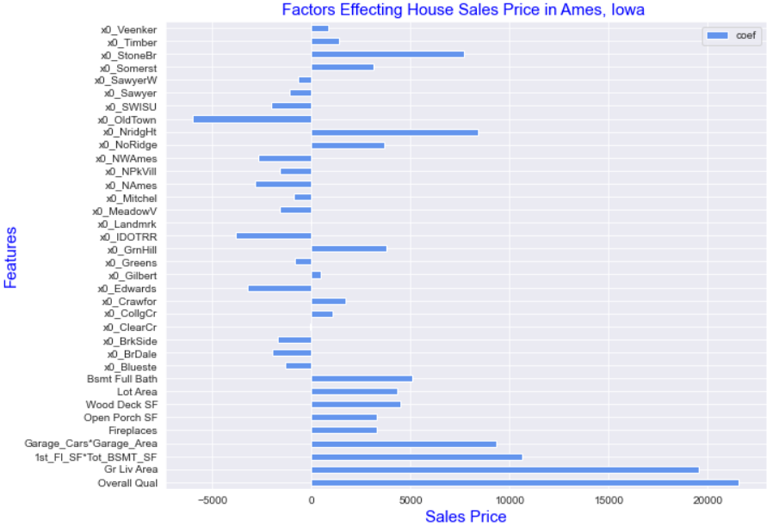
Visualizations - Features in Final Model
Bar Chart of Coefficients of Features
Ridge Train RMSE: $25892
Ridge Test RMSE: $30058
~~~~~~~~~~~~~
Ridge Training Score: 0.87
Ridge Testing Score: 0.85
Notes:
After numerous model testing these are the features I found provided the lowest training and test RMSE, and highest adj r2 scores. It consists of the dummy coded neighborhood variables, the interaction terms, and the features with the highest correlation to sales price.
After plotting it was evident Overall Quality and Ground Living area had the highest affect to Sales Price. Our model showed us the specific Neighborhoods that are actually detrimental to Sales Price such as Oldtown, Briardale, Iowa DOT and Rail Road.
Ridge Train RMSE: 25892.370009359773
Ridge Test RMSE: 30058.12231381813
~~~~~~~~~~~~~
Ridge Training Score: 0.875353908294892
Ridge Testing Score: 0.8512485297058392
- Overall Qual (21571), Gr Liv Area (19518), 1st_Fl_SF*Tot_BSMT_SF (10648), Garage_Cars*Garage_Area (9342), Fireplaces (3271), Open Porch SF(3278), Wood Deck SF (4506), Lot Area (4306), Bsmt Full Bath (5097) are the features with the highest positive impact on price.
- NoRidge (3643), NridgHt (8423), GrnHill (3790) and StoneBr(7707) Somerst( 3109) are the top 5 neighborhoods with the highest positive effect on Sales Price
- OldTown(-6001),IDOTRR(-3826), Names (-2868), Edwards (-3250), seem to be the neighborhoods with the highest adverse effects on Sales Price.

Slide 9
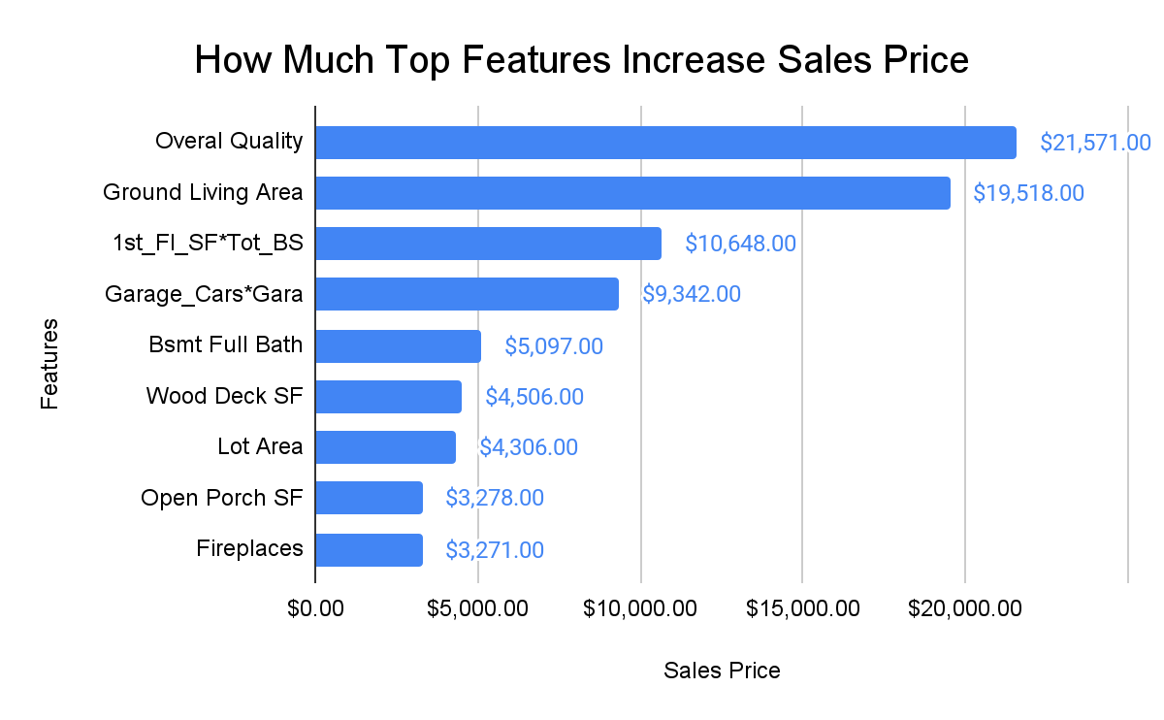
Top Features
Notes:
After checking significance values these are the 9 terms in order of their effect on Sales Price holding all other variables constant.
Go over each variables affect.

Slide 10
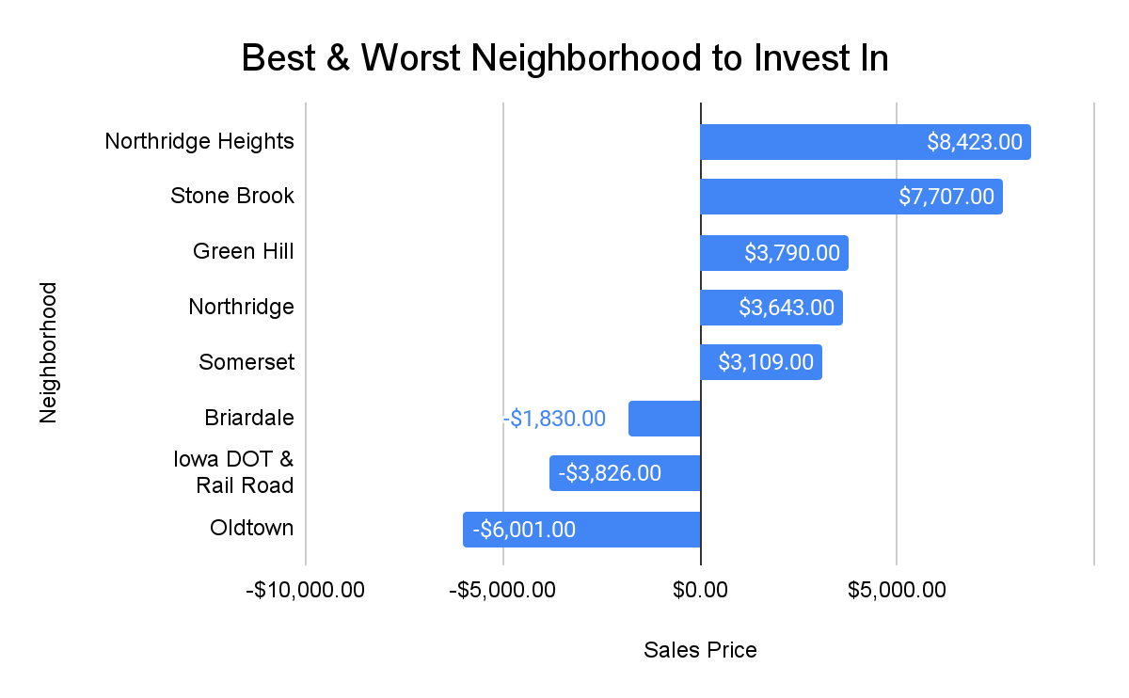
Top Features - Neighborhoods
Notes:
Review neighborhoods
I did additional research as to why these three neighborhoods decreased Sales Price so much and found Old Town is a historically preserved area in Ames, Iowa and residents tend to avoid living in this neighborhood as there are many constructing restrictions. Briardale is close to a noisy highway and not an ideal area for families in Iowa, which is the same complaint the Iowa Dot and RR neighborhood has as its close to the railroad.

Slide 11
Conclusion of Findings
1) The overall material and finish quality of a home is the most important feature affecting Sales Price.
2) Having an a big garage that can fit more than one car improves Sales Price greatly
3) A full bath in the basement is one of the most valuable additions to a house.
4) A fire place is a great appeal for houses in Ames, Iowa
5) Location can greatly increase or decrease the final sale price of the home
Notes:
To conclude my findings, the feature that improved Sales Price the most was Overall Quality - The criteria for determining the finish quality of the home should be carefully considered since the potential return can be the biggest.
Having an adequate sized garage that can fit more than one vehicle is essential to homeowners in Iowa since most family have access to more than one vehicle.
Homeowners transform their basements into bedrooms, entertainment rooms, game rooms and more - having an access to a full bathroom in the basement is a highly sought after feature.
With an average winter temperature of 14 degrees fahrenheit, a fire place is another feature that improves property value in Iowa.
Lastly, the neighborhood should be considered as much as overall material as some neighborhoods can decrease the final price of a home.
So where exactly should real estate investors prioritize their funds?

Slide 12
Recommendations
GOOD
LOCATION
Northridge Heights, Stone Brook, Green Hill, Northridge, and Somerset
BAD
LOCATION
Old Town, Briardale, Iowa DOT and Rail Road
INVEST IN GARAGE AREA
Spacious garages able to hold at least 2 cars
COMFORT
Fireplace, full bath in BSMT, large lot and wooden deck area, and open porch
1st Floor & Basement SQFT
These features in combination can bring an additional $10K to the value
Notes:
My recommendation is to specifically target the neighborhoods close to the universities and town centers that have high positive Sales Price like Northridge Heights, Stone Brook, Green Hill, Northridge, and Somerset. Avoid investing in neighborhoods that are near noisy or historically preserved areas like Old Town, Briardale, Iowa DOT and Rail Road.
Investing in adequate garage space able to hold 2 cars will yield positive ROI, as well as in investing in making spacious homes with large lots, wooden decks, and open porches.
Special features to include would be a fireplace for the cold winters, and full bath in the basement according to the data.
An area to especially consider would be the square footage of the first floor and basement together as this showed to have a significant increase to the final Sales Price.
Lastly, I recommend a future study diving into the data regarding features homeowners find most attractive and desire specifically in Ames, Iowa. A suggestion would be to develop survey data to aid in determining what are sought after features currently not offered in the market.

Slide 13
Thank You!
Does anyone have any questions?

Slide 14
RESOURCES
Articles and Data Referenced
https://www.ortalheat.com/blog/which-features-do-americans-want-in-their-dream-home-hint-a-fireplace-is-on-the-list
https://eyeonhousing.org/2019/09/share-of-new-homes-with-fireplaces-drops-to-record-low/
https://datausa.io/profile/geo/ames-ia/
https://livability.com/best-places/2021-top-100-best-places-to-live-in-america/top-100-2021-ames-ia/
https://www.desmoinesregister.com/story/news/2021/10/22/livability-lists-three-iowa-cities-top-100-best-places-live-des-moines-ames-iowa-city/6123796001/
https://policyadvice.net/insurance/insights/how-many-americans-own-cars/
Notes:
- https://www.ortalheat.com/blog/which-features-do-americans-want-in-their-dream-home-hint-a-fireplace-is-on-the-list
- https://eyeonhousing.org/2019/09/share-of-new-homes-with-fireplaces-drops-to-record-low/
- https://datausa.io/profile/geo/ames-ia/
- https://livability.com/best-places/2021-top-100-best-places-to-live-in-america/top-100-2021-ames-ia/
- https://www.desmoinesregister.com/story/news/2021/10/22/livability-lists-three-iowa-cities-top-100-best-places-live-des-moines-ames-iowa-city/6123796001/
- https://policyadvice.net/insurance/insights/how-many-americans-own-cars/
- https://www.google.com/maps

